Slide 1
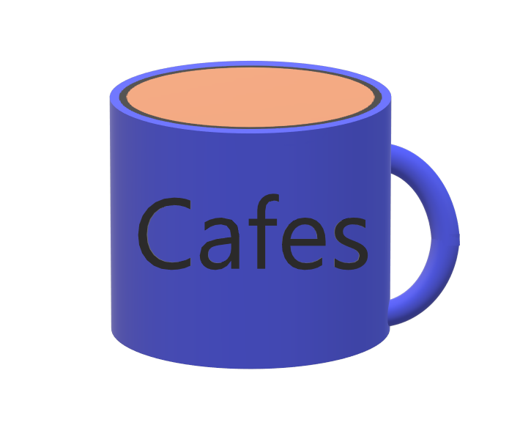
SA Presentation
By: Cafes

Slide 2
Team Members
Jon – Team Lead 1
Ross- Team Lead 2
Riley- Team Lead 3
Kyle- Team Lead 4
Trevor- Team Lead 5
Hunter- Team Lead 6

Slide 3
Introduction
Stymphalian
Open world RPG
Goal—Beat the Stymphalian
Bird From Greek Mythology
Notes:
Riley Trevor

Slide 4
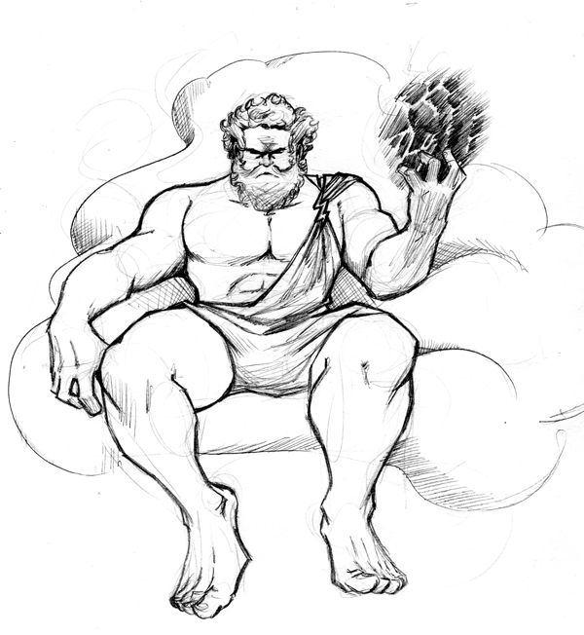
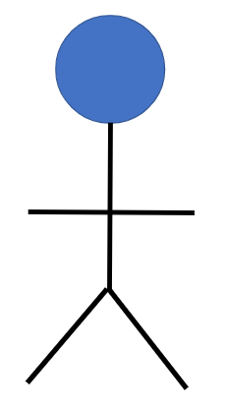
Hercules
The story begins on Mt. Olympus, where the main character, Telephus, is having a conversation with his father, Hercules. Throughout his life, Hercules sought the extinction of the Stymphalians: creatures who had been inhospitable toward him. Hercules knew that these Stymphalians could only be killed by an arrow tipped with the blood of a hydra. Resultingly, Hercules slew many hydras and used their blood to nearly wipe out all his foes. However, Hercules had recently became poisoned by the blood of a hydra and was slowly dying. Unable to complete his goal of eradicating the Stymphalian, Hercules asks Telephus to complete the task. Telephus accepts and jumps off Olympus, eager to fulfill his dying father's wish.
Telephus

Slide 5


Telephus lands on the Island of Aretias, home of the last Stymphalians in existence. Using his experience from the Trojan War, Telephus quickly learns the basics of surviving on Aretias. He also learns that the remaining Stymphalians are seated at the top of a nearby volcano. Telephus heads to a nearby town at the base of the volcano to rest up before starting the climb. In town, Telephus hears rumors of a hydra cave somewhere on the volcano. With the stars aligned, Telephus' quest can now truly begin.
Olympus
Aretias

Slide 6


Throughout his journey, Telephus will encounter numerous townsfolk that could use a hand. Should he choose to accept and complete quests from these townsfolk, Telephus will receive a reward, such as gold, items, and equipment.

Slide 7
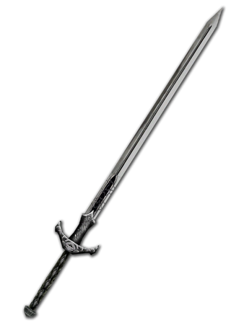


Items can be used in and outside of combat, to assist Telephus in whatever situation he finds himself in. Certain items, such as hydra's blood, have special uses that are crucial to completing Telephus' main quest.
Equipment can be used to make Telephus more effective at fighting the common monsters on Aretias.

Slide 8
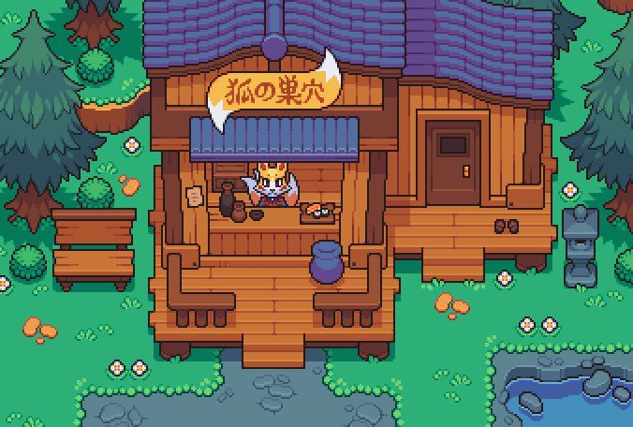
Through completing quests and looting monsters, Telephus will acquire gold. This gold can be exchanged for items and equipment at shops around Aretias.
Telephus can also exchange unwanted items and equipment for gold at these shops.

Slide 9
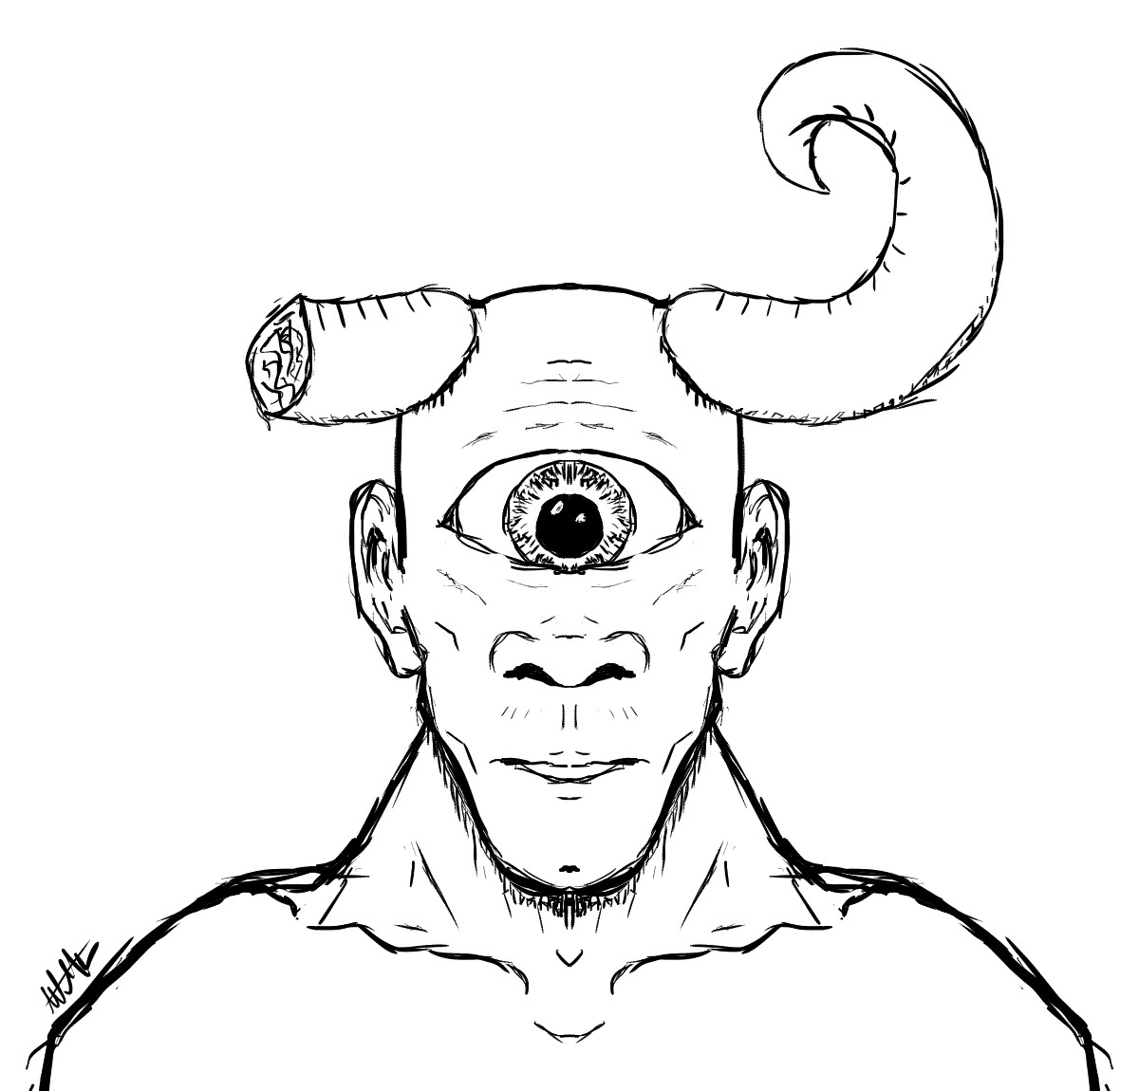
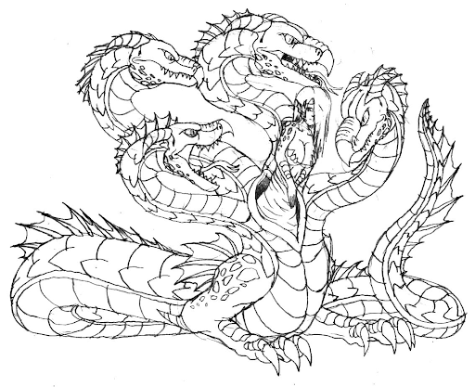
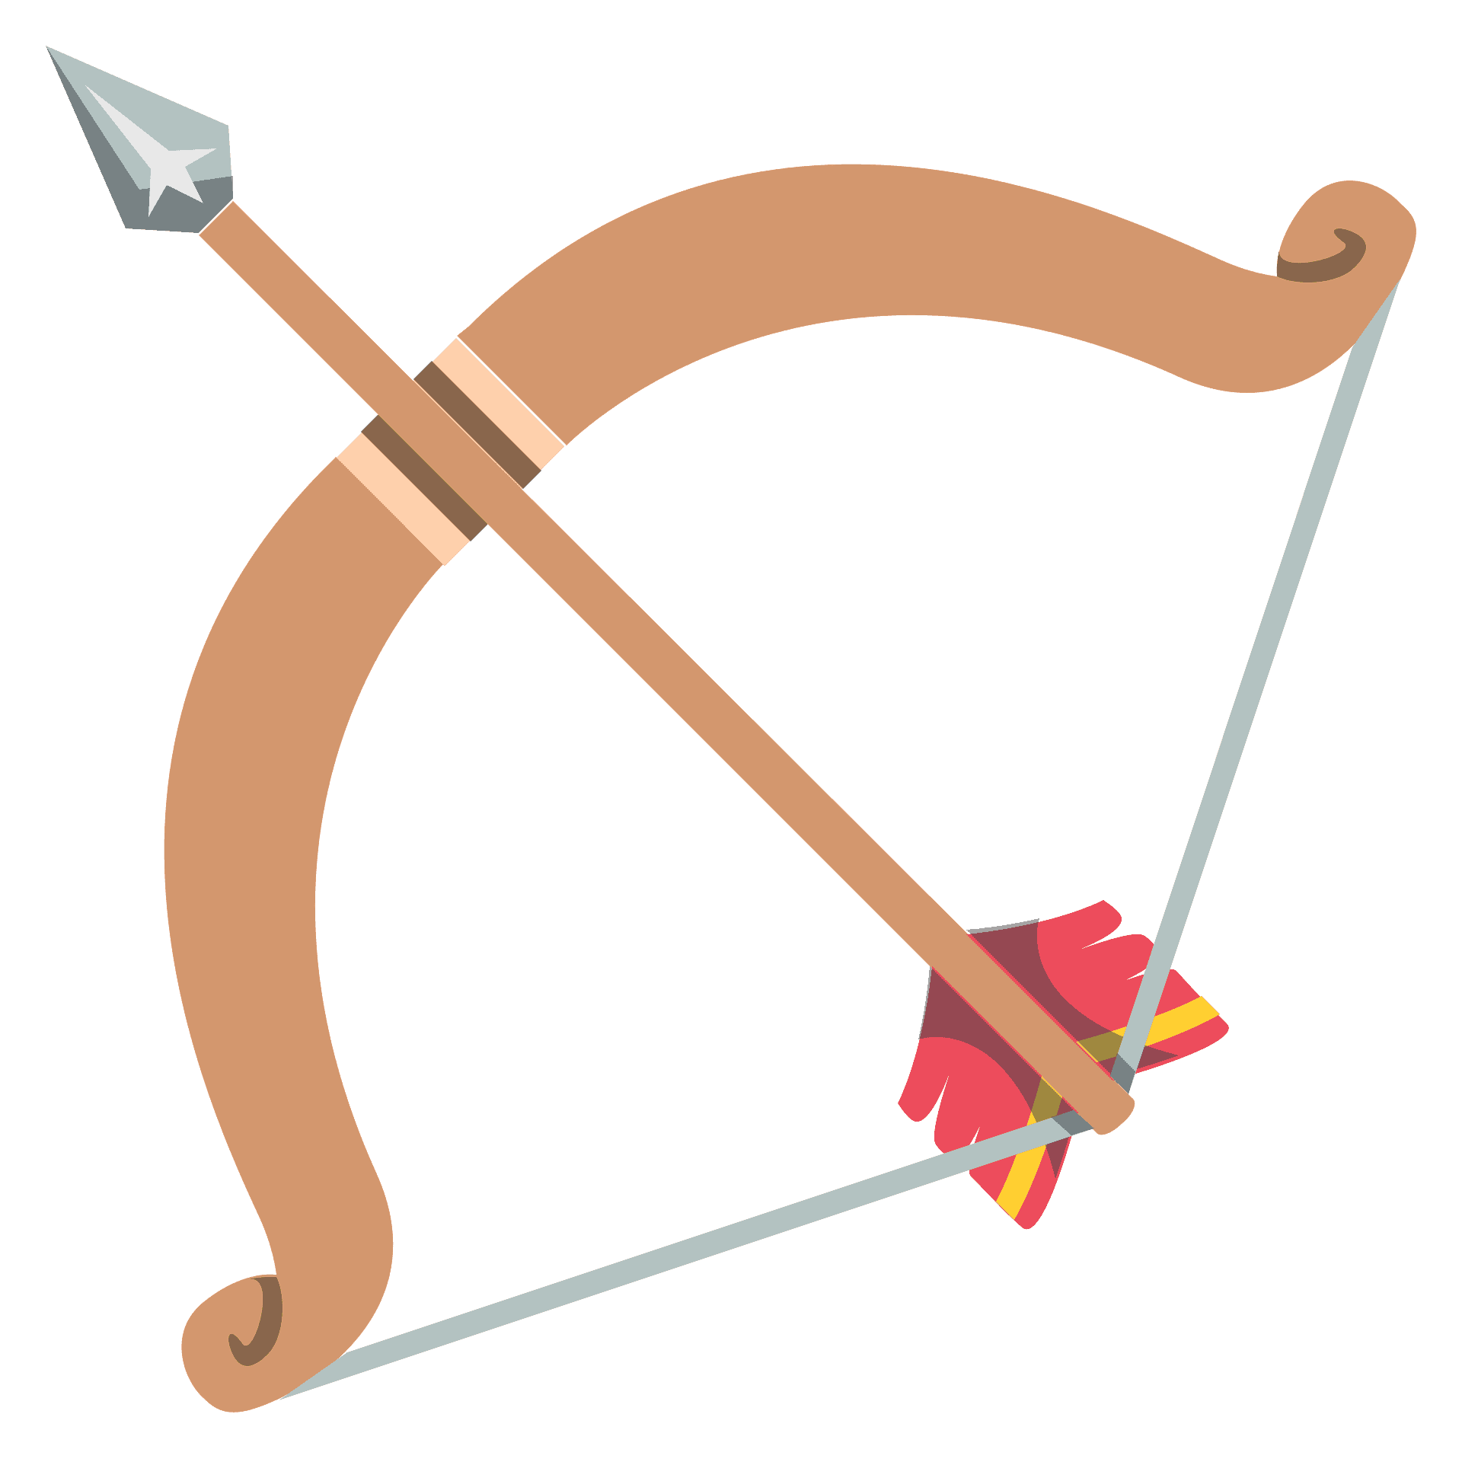
There are powerful creatures on Aretias that require unique approaches to combat. If Telephus can best these creatures, then he will acquire special items needed to complete his main quest.
Killing these creatures may not be necessary: there are other ways to get a creature's special item.

Slide 10


Telephus' main quest will come to an end once the Stymphalians at the top of the volcano are slain.
The Stymphalians will not come out of their nests unless provoked
Hydra blood, a bow, and some arrows will be needed to ensure the demise of the Stymphalians
Once the quest is complete, Telephus will ascend back to Olympus and inform his father of the good news.

Slide 11
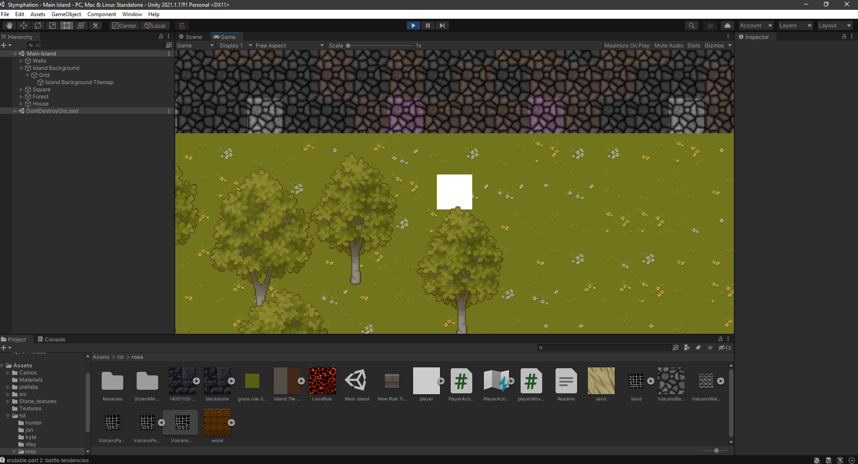
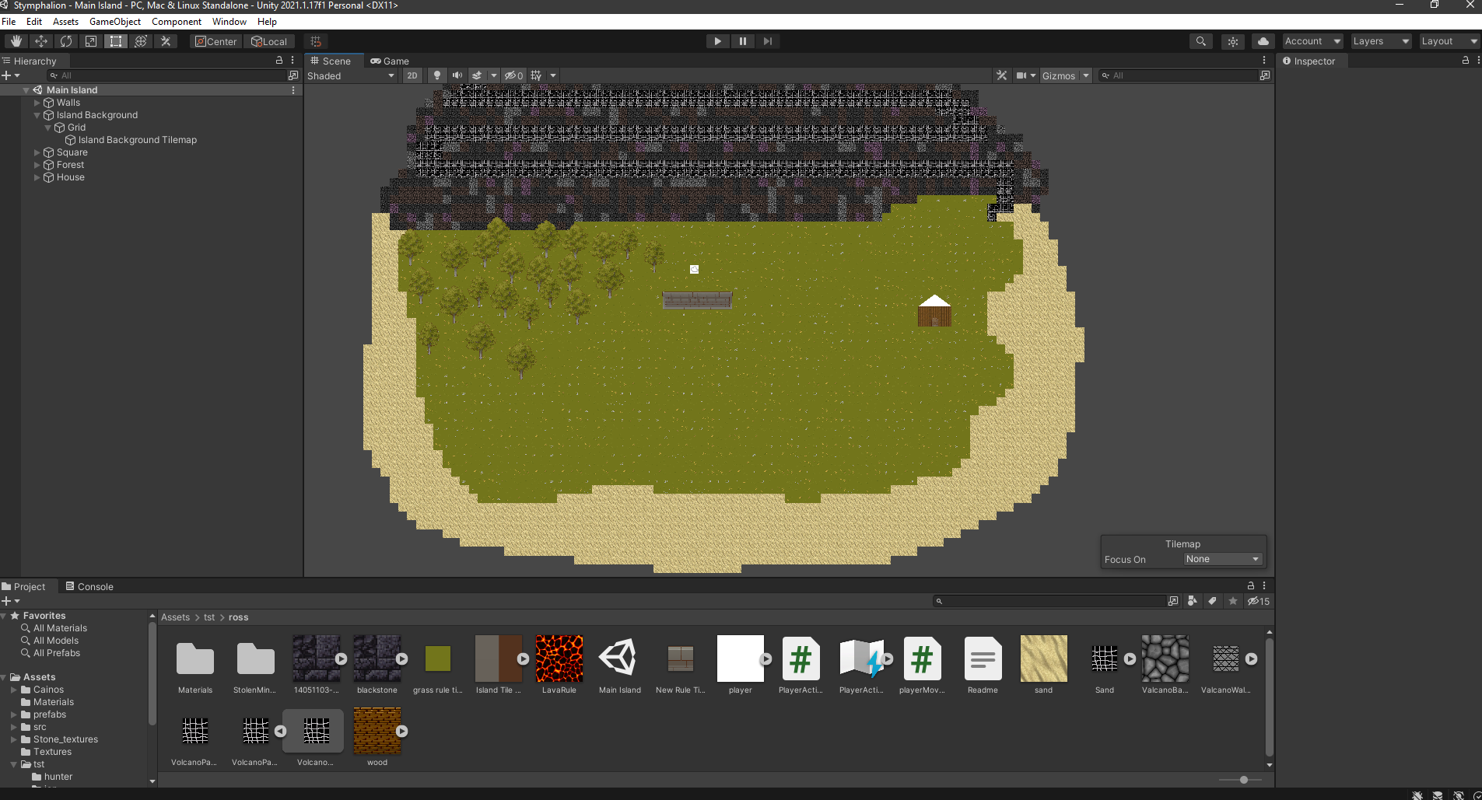
Current Game Screenshots

Slide 12
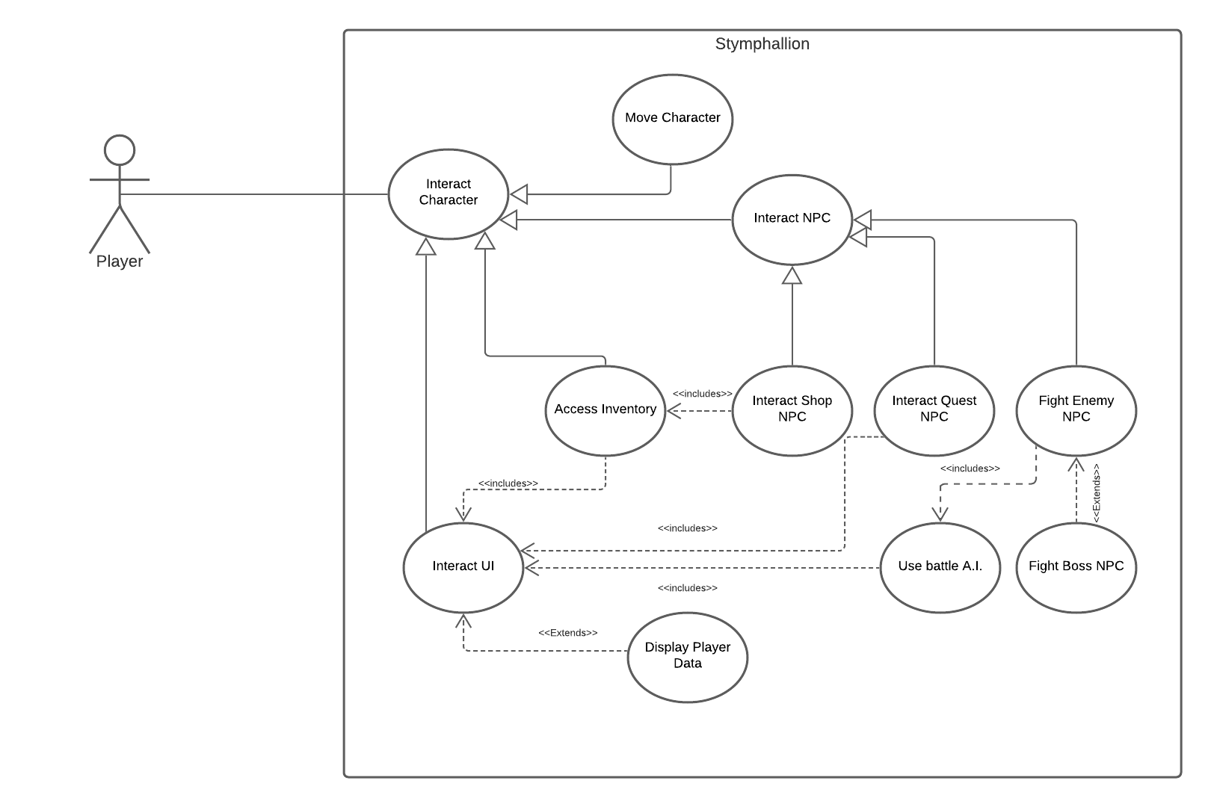
Global Use Case
Notes:
Ross

Slide 13
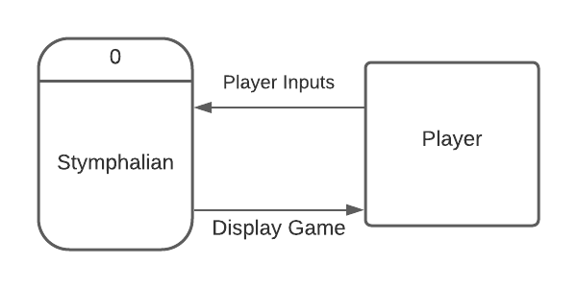
Context Diagram
Notes:
Jon

Slide 14
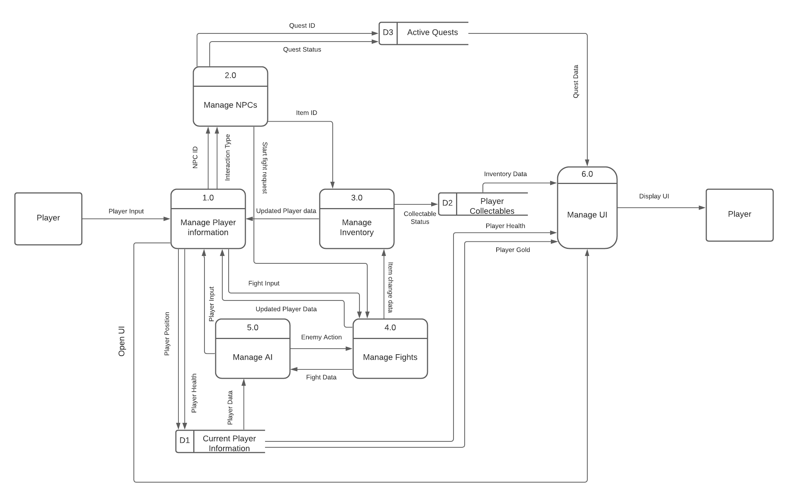
Diagram 0
Notes:
Jon Kopf

Slide 15
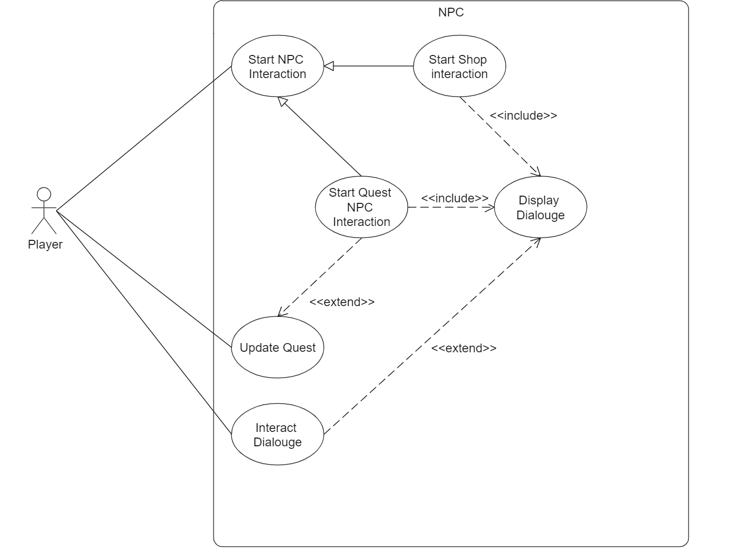
Quests and NPCs - Jon
High Priority
Medium to high complexity

Slide 16
Manage Player Information- Ross
Create Open World
Placement of interactable objects
Making scenes look nice (tilemaps, interactable objects)
Input
Make sure input call correct functions
High Priority
Medium Complexity

Slide 17
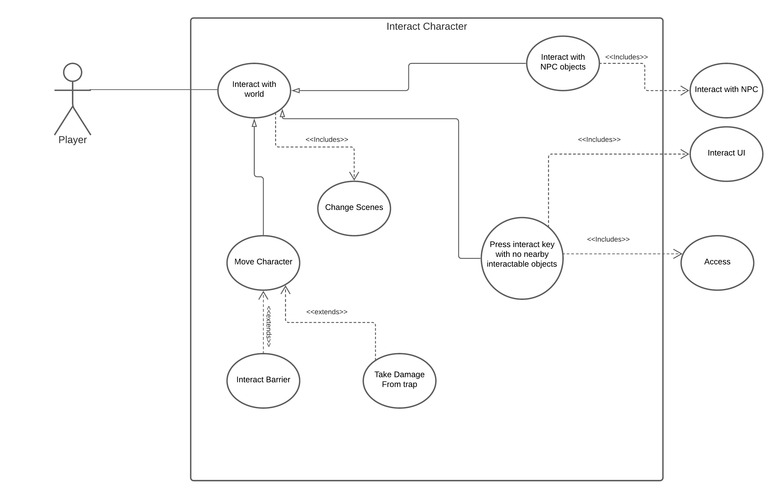
Player Information cont.

Slide 18
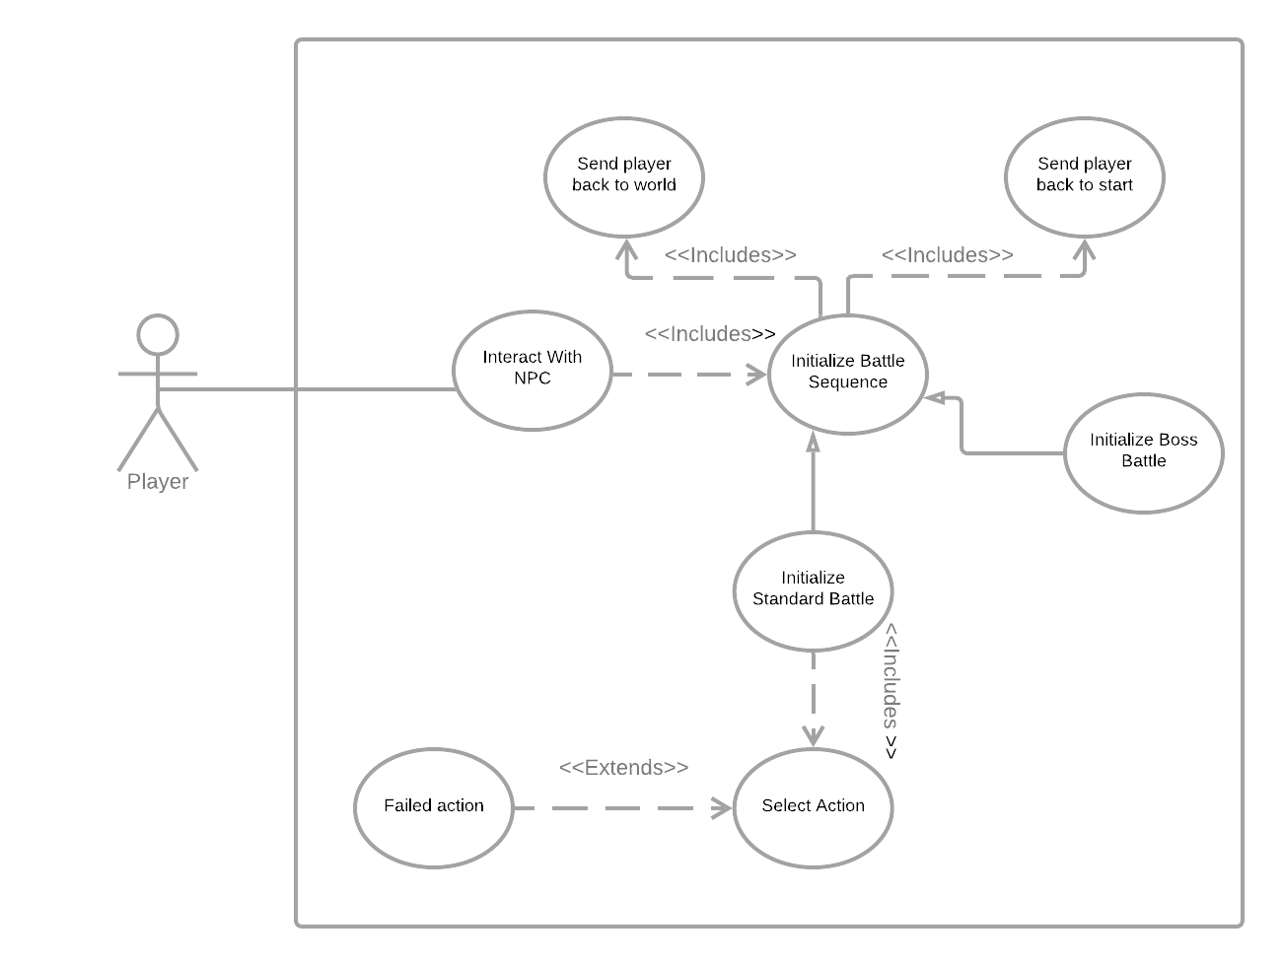
Create Battle System - Riley
Priority: High
Complexity: Medium
Notes:
Jon Kopf

Slide 19
Create Battle System cont.
Develop a combat scene when interacting with enemy NPCs
Two types of combat
Standard enemy combat
Player chooses from different actions
Battle continues until either the player or enemy run out of health
Boss combat
Goes to separate minigame if certain conditions are met
Battle continues until player dies or win condition is met
Notes:
Jon Kopf

Slide 20
Create and Manage UI- Hunter
Develop user interfaces that display information based on player input
Inventory
Player stats
Quests
Develop HUD
Create menus
Main
In-game
Settings
Priority: High
Complexity: Medium
Notes:
Jon Kopf

Slide 21
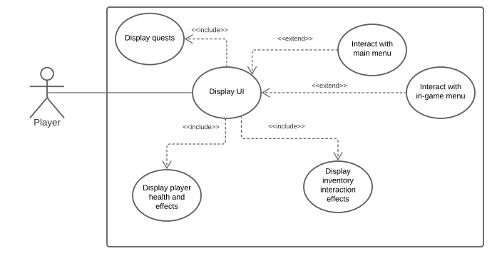
Create and Manage UI- Continued
Notes:
Jon Kopf

Slide 22
A.I. - Trevor
Create Demo Mode A.I. for player
Create battle A.I. for enemies
Using various values such as the player's health, enemy behavior, and enemy actions, determine the correct action to use.
Feature priority: Medium
Game can function without complex enemies, but having them greatly improves it.
Complexity compared to other features: Medium-High
Complexity will vary depending on how many possible actions we allow an enemy to have.
Notes:
Jon Kopf

Slide 23
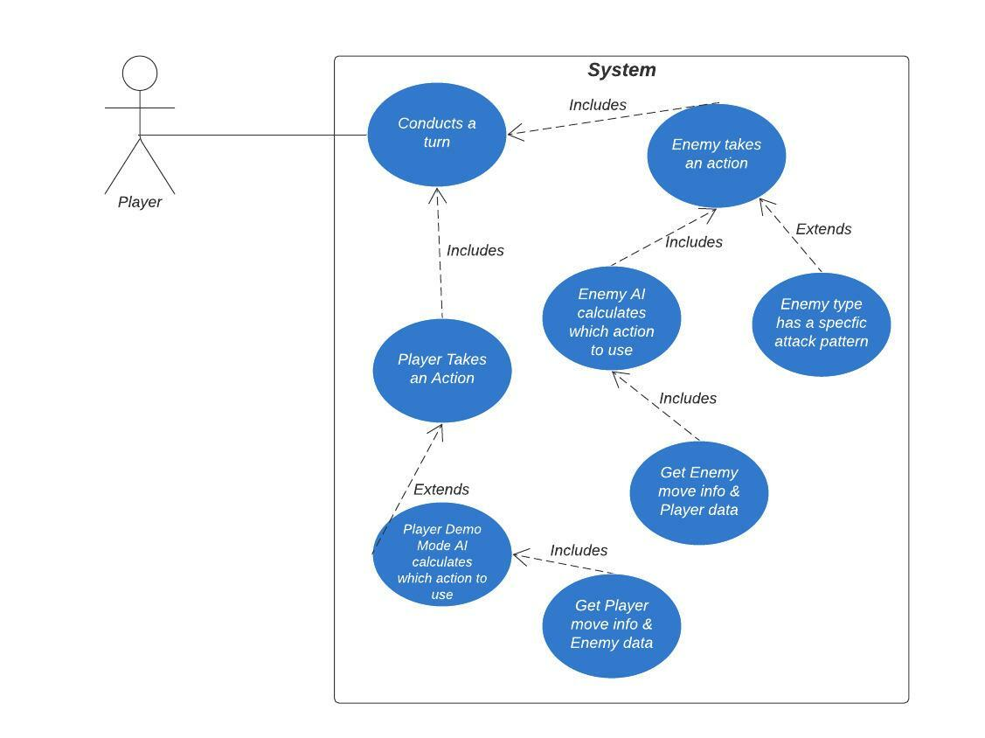
A.I. Continued
Notes:
Jon Kopf

Slide 24
Inventory System - Kyle
Inventory Superclass
Display items, stats
Equipped items
Player sub-class
Inventory sub-class
Items class
Struct

Slide 25
Inventory System
Priority – High
All pickups stored
Hydra blood, Krotola
Sword and bow
Complexity – High
Item class with structure
Icon, stats, animation
Lots of special cases
Storage capacity, items stacking, items already equipped

Slide 26
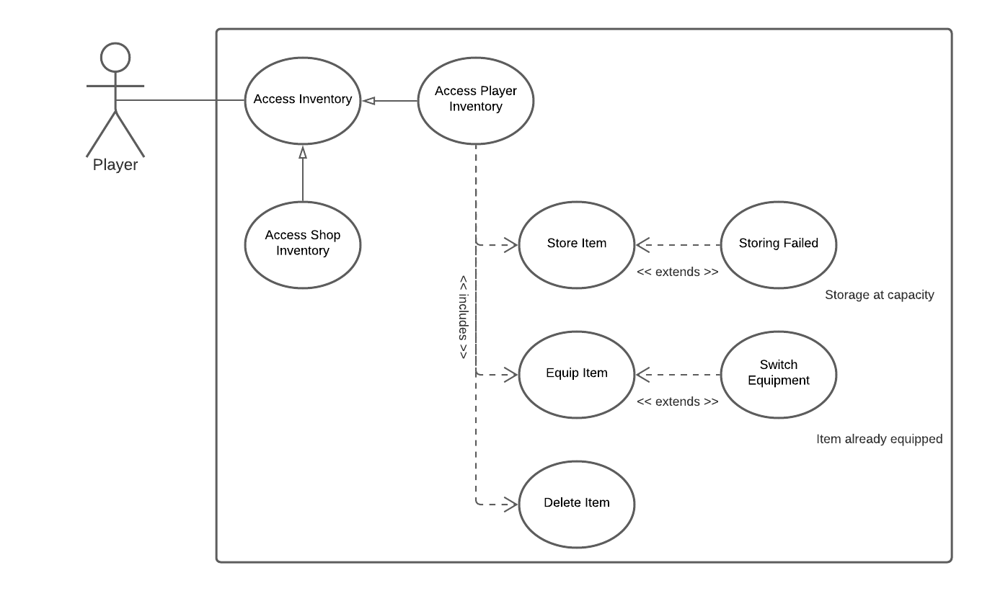
Inventory System

